Slide 1
On Enhancing Hierarchical Modulations
Shu Wang, Byung K. Yi and Soon Y. Kwon
LG Electronics Mobile Research, USA

Slide 2

Introduction
Hierarchical modulations are widely used in digital broadcast system design such as
  Dedicated network: DVB-T, Media-FLO, UMB-BCMCS.
  Hierarchical network: DVB Multiplexing.
Hierarchical modulations can help
  provide different QoS’s to users with different profiles, e.g. higher throughput for users with advanced receiver.
  provide unequal protection on different contents, e.g., video, audio, text.
  update system to provide better service to new users with advanced receiver with keeping existing users unchanged.
The enhanced hierarchical modulation scheme by rotating enhancement layer(s) is investigated here for the next generation system in terms of
  an information theoretic perspective: achievable throughputs
  a signal-processing perspective: inter-layer interference, effective SNR, effective power, modulation efficiency.
  an implementation perspective: peak-to-average power ratio (PAPR)
These criteria can be used for optimizing and evaluating layered/hierarchical transmissions in the future too.

Slide 3
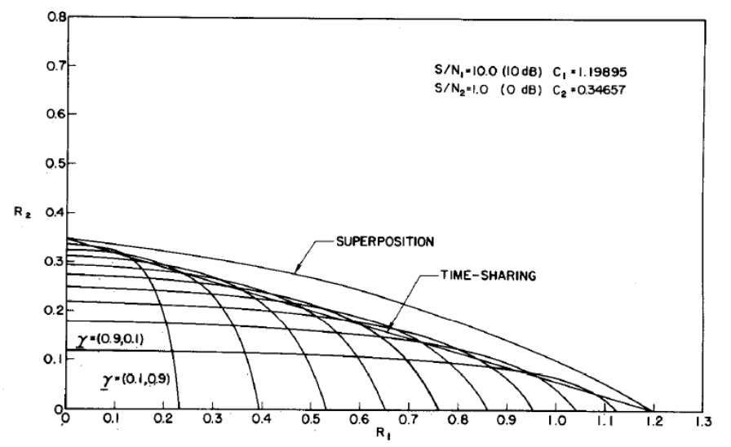
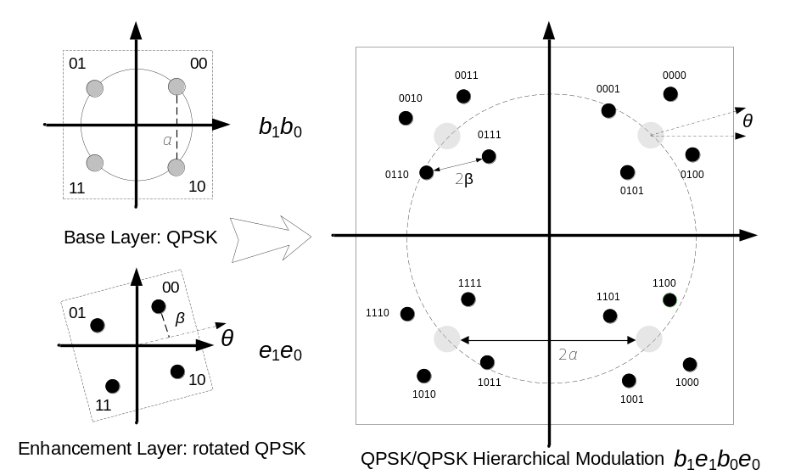
Superposition Precoding and Hierarchical Modulation
Achievable rates, ( Bergmans and Cover, 1974 ).
Optimal broadcast channel capacity is achievable by superposing two users’ signal together.
Superposition precoding with interference cancellation outperforms TDM and FDM schemes in most time.
Hierarchical modulation is one of the popular implementations of superposition precoding.

Slide 4
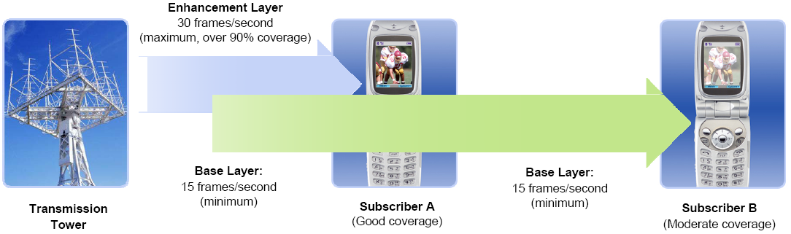
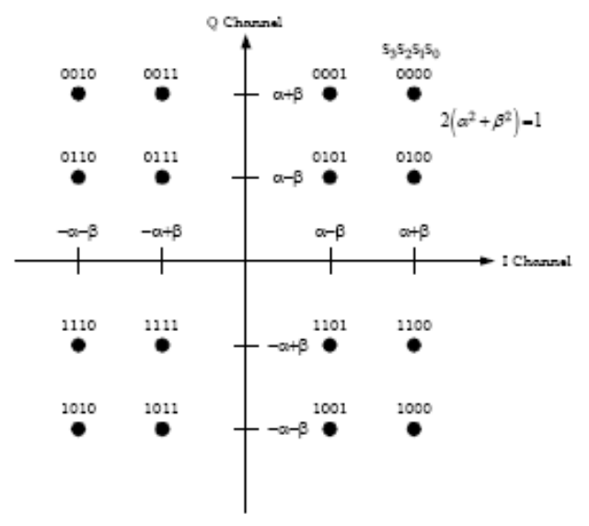
Hierarchical Modulation in Standards (1/2)
Media-FLO supports hierarchical transmission of base/enhancement layers
  Extends coverage with layered source coding
  Provides a more graceful degradation of reception.

Slide 5
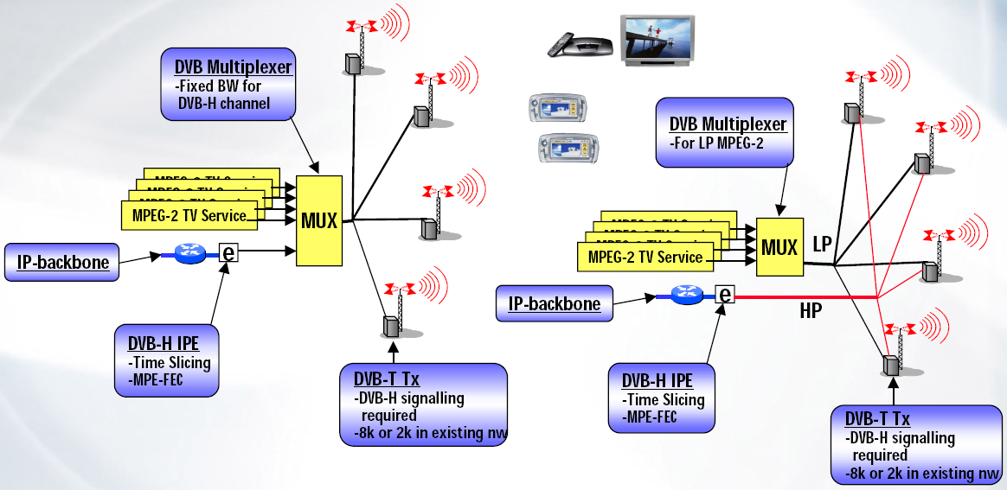
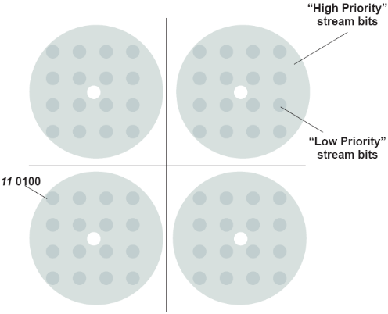
Hierarchical Modulation in Standards (2/2)
DVB-T -- QPSK/64QAM, 13.6/4.5Mbps with coding rate ¾ and ½.
Besides using a dedicated DVB-H network, DVB-H service can also be embedded into DVB-T network using hierarchical modulation.
  DVB-H service use the HP input while DVB-T services use LP.
  The HP input can offer increased robustness in mobile environment over the LP input
  The LP input can serve higher bit-rate for fixed reception service

Slide 6
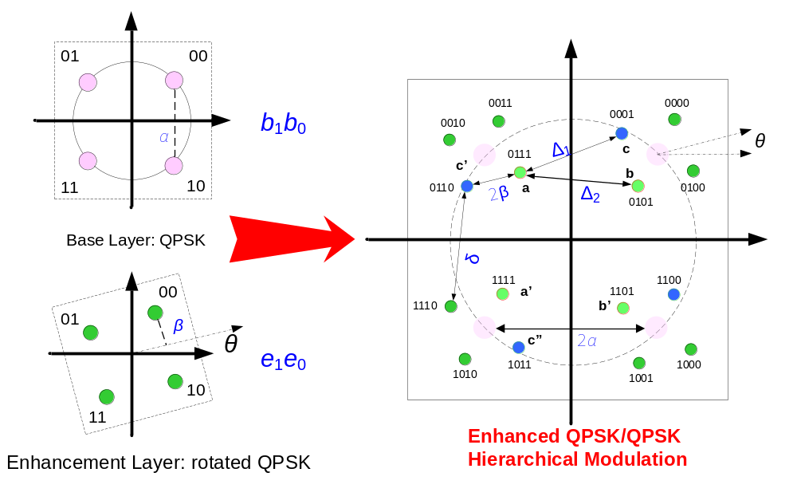
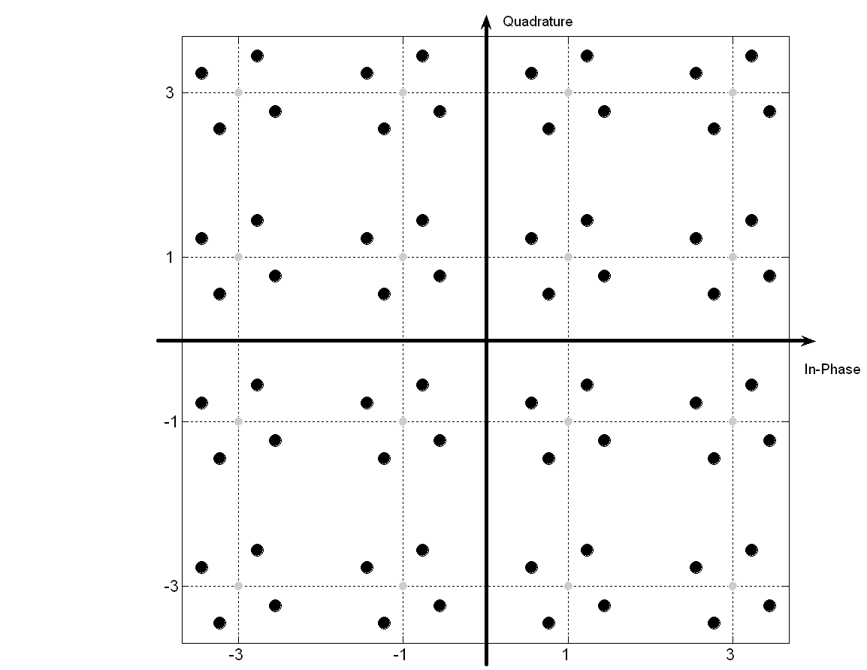
Enhanced Hierarchical Signal Constellation
The key advantage: minimum complexity increase.
The major gain: higher throughput on the base layer
The extra benefit: lower bit-error rate on the enhancement layer
There are a couple of ways to find the best rotation angle:
if the target SNR’s are known, maximizing the sum capacity of the two layers.
if only the power splitting ratio is known, optimizing Euclid distance profile.
another practical approach is to find the best angle by simulations.
QPSK/16QAM Hierarchical Modulation

Slide 7
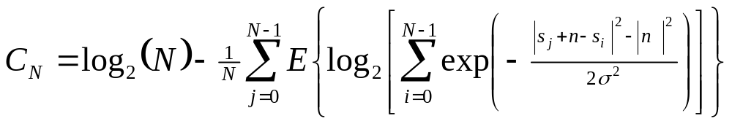
Channel Capacity using N-ary Modulation
The capacity of a general N-ary modulation can be written by
Signal Constellation and Euclid Distances Profile
n denotes normally distributed complex-valued noise with variance σ²

Slide 8
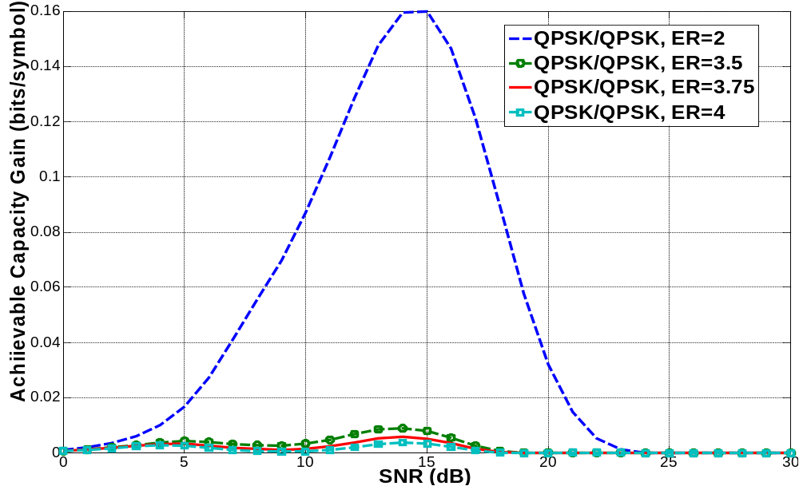
Achievable Gains (1/2)

Slide 9
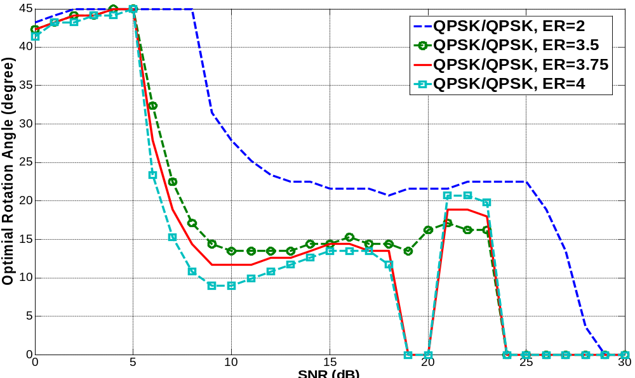
Achievable Gains (2/2)

Slide 10
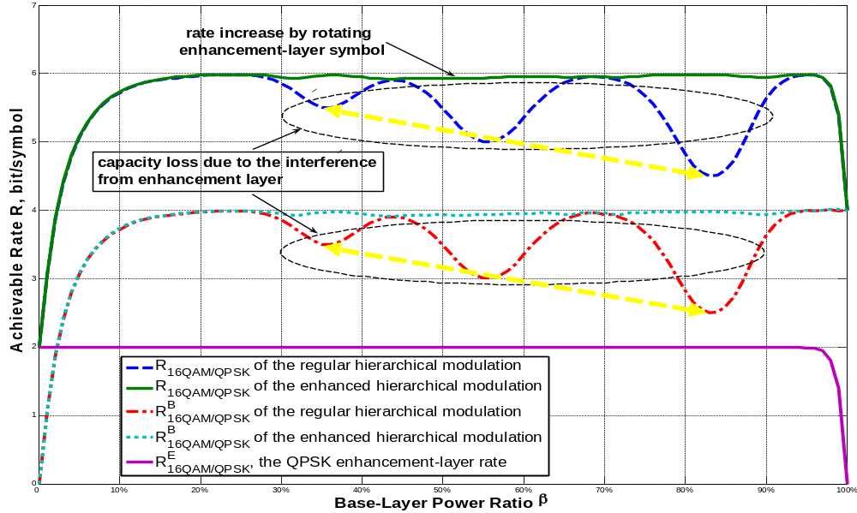
Achievable Rates: 16QAM/QPSK
P/σ²=(P₁+P₂)/σ²= 23dB

Slide 11
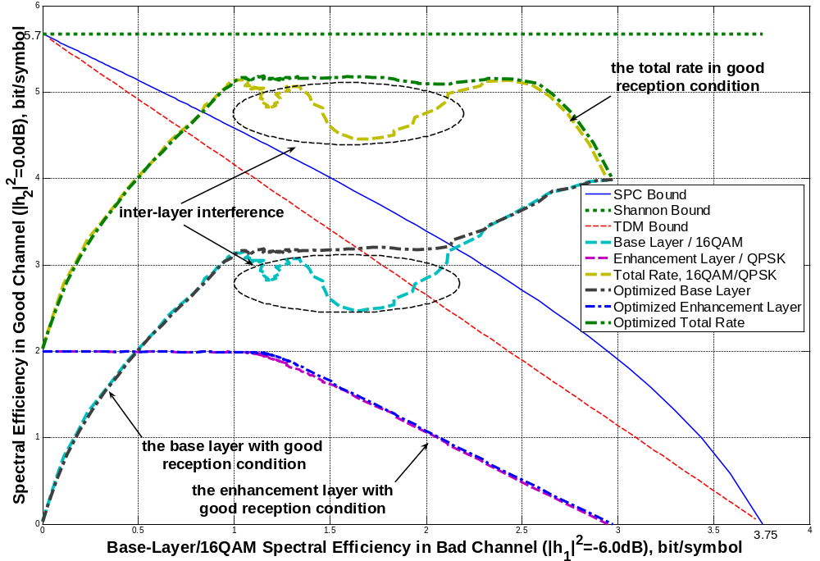
Constrained Throughput of Hierarchical Modulations

Slide 12
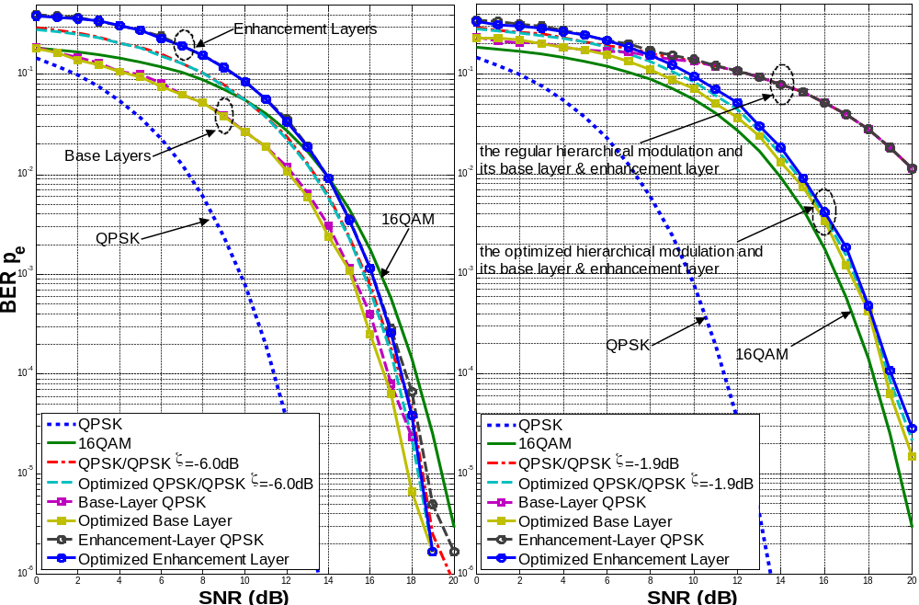
Inter-Layer Interference

Slide 13
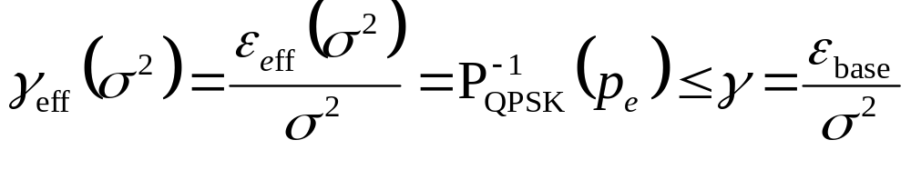

Effective Signal-to-Noise Ratio
Effective SNR γ_{eff} is defined as the SNR necessitated when the base layer signal is sent alone with the same power.
  Effective SNR always is less than the actual SNR.
  The required symbol energy for achieving the same BER is called effective power, which is smaller than actual base-layer signal power.
  For example, For QPSK/QPSK hierarchical modulation, the effective SNR of base-layer BER p_{e} is given by
Due to inter-layer interference, effective SNR or effective power is less than actual SNR or power. Stronger inter-layer interference is and smaller effective SNR/power becomes

Slide 14
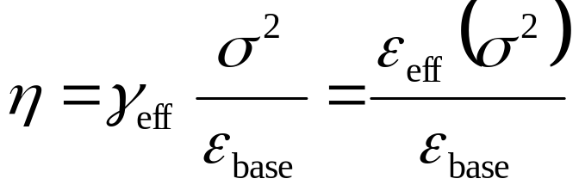
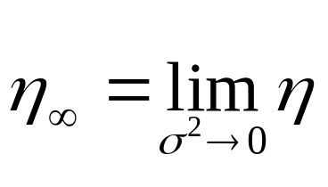
Modulation Efficiency (1/2)
Modulation efficiency of a modulated signal is defined by the ratio between effective SNR and actual SNR.
Modulation efficiency is not greater than 1.
Modulation efficiency, as well as effective SNR and effective power, is the parameter proposed by us for evaluating the performance of the whole transceiver chain, including modulation and demodulation.
Asymptotic modulation efficiency is the ratio when the SNR becomes very large and interference becomes dominant.
Asymptotic modulation efficiency is proposed by us for evaluating the interference resistance capability of both hierarchical modulation scheme and demodulation scheme.

Slide 15
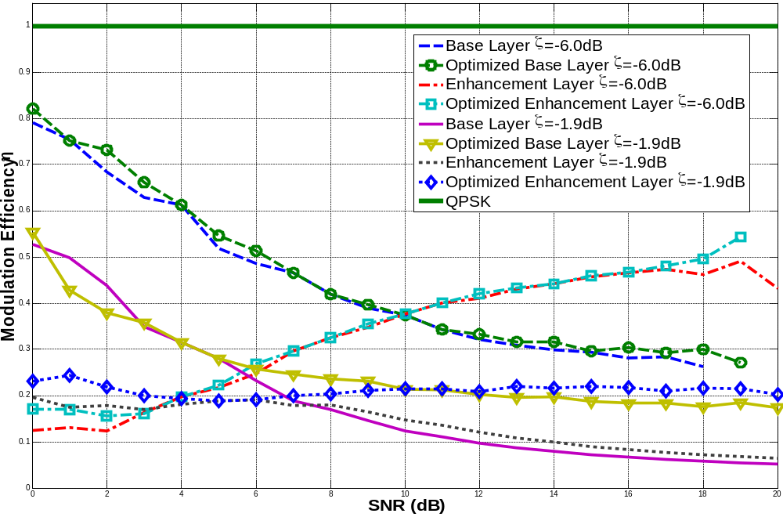
Modulation Efficiency (2/2)

Slide 16
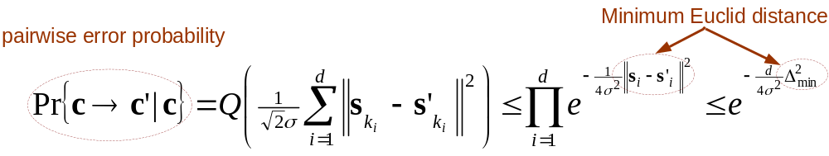
PEP and Minimum Euclid Distance
A upper bound for pairwise error probability (PEP) can be derived with assuming
  The Hamming distance is d << K: two codeword c and c’ differ in d bits.
  Perfect interleaving.
Observation: PEP is dominated by the terms with the smallest squared Euclid distance in high SNR region

Slide 17
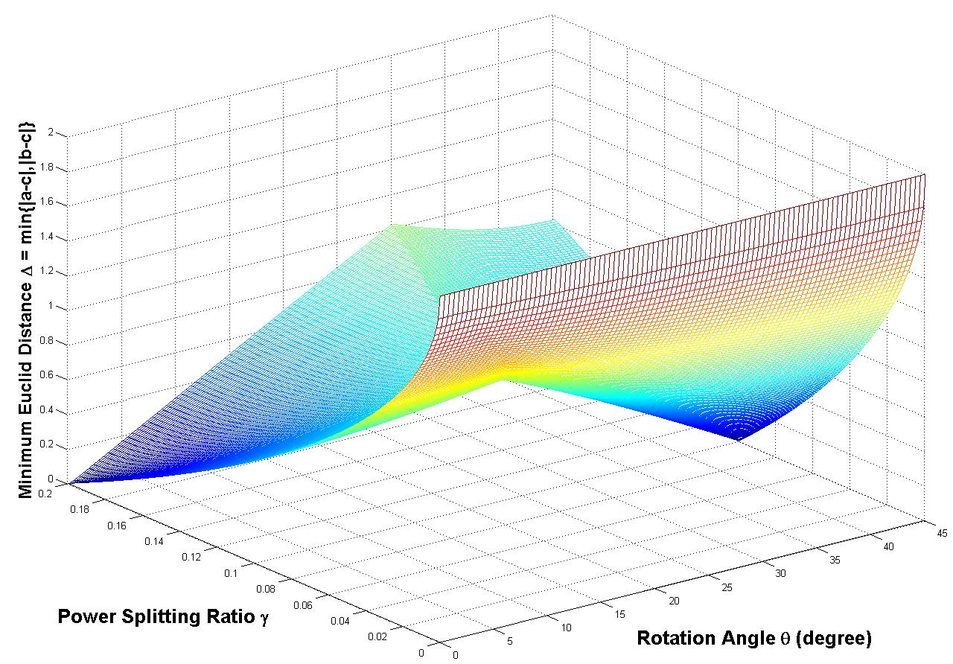
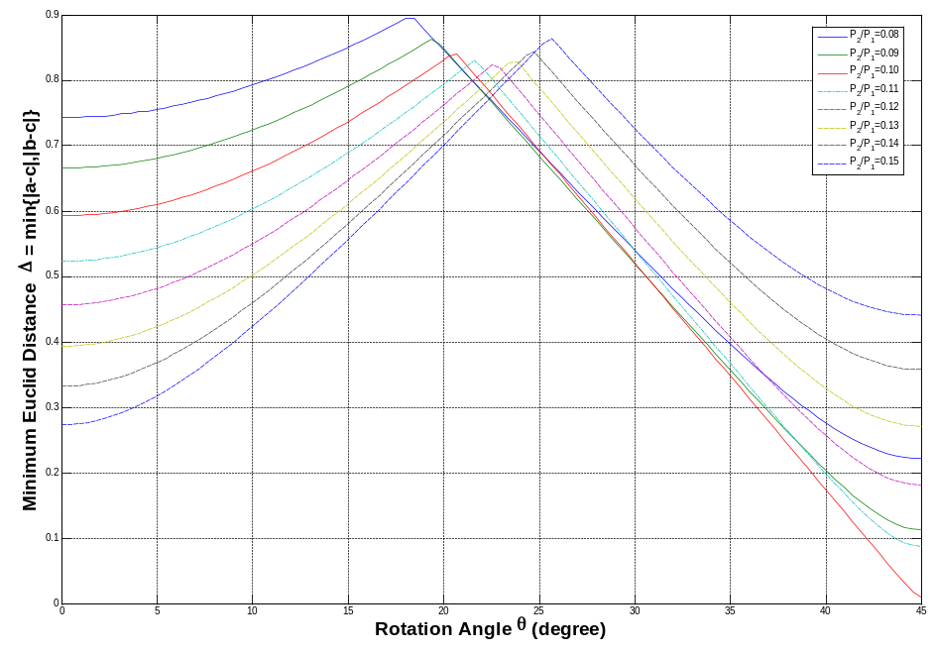
Minimum Euclid Distance: QPSK/16QAM

Slide 18
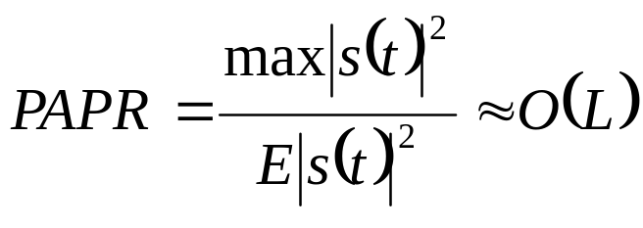
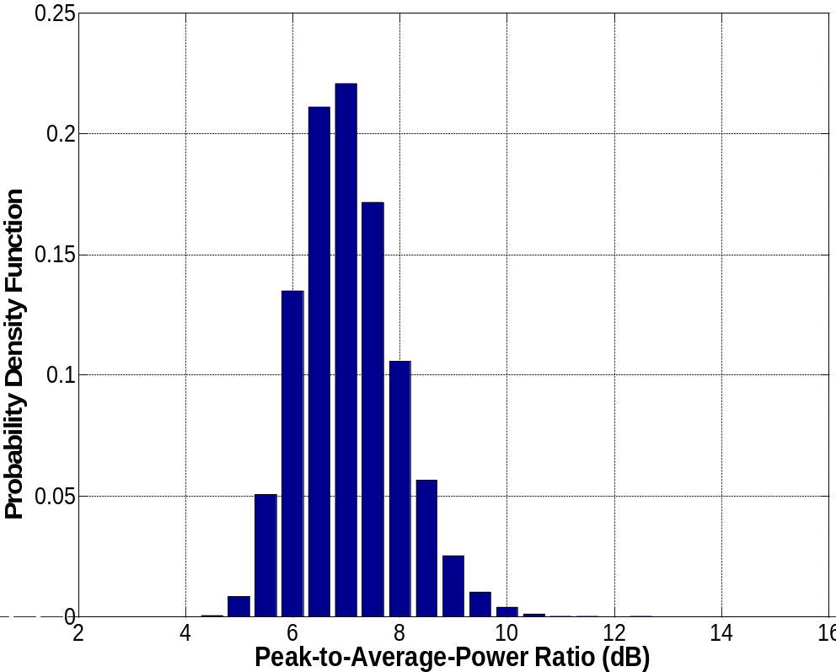
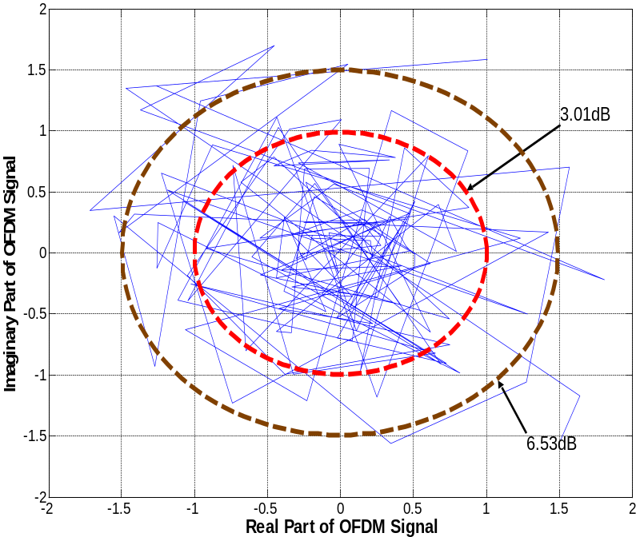
PAPR of OFDM
8PSK, L=128

Slide 19
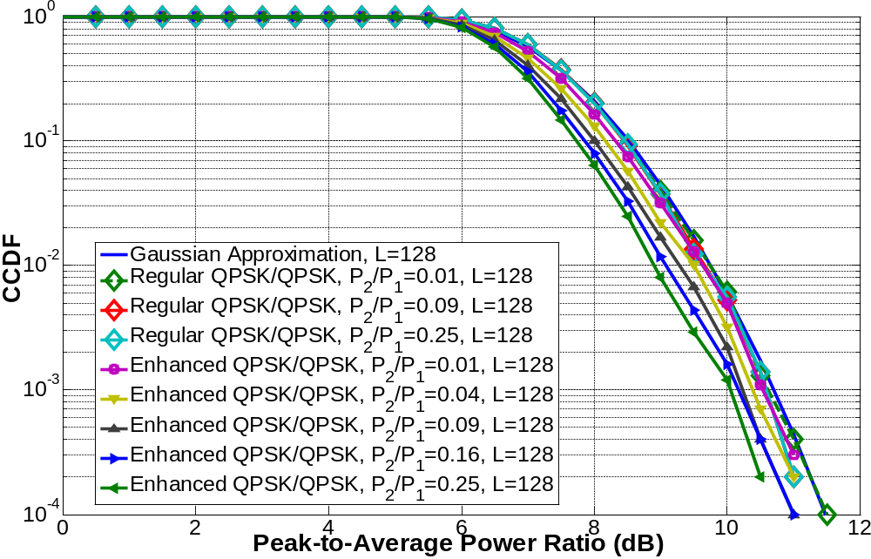
Hierarchical Modulation with Rotation

Slide 20
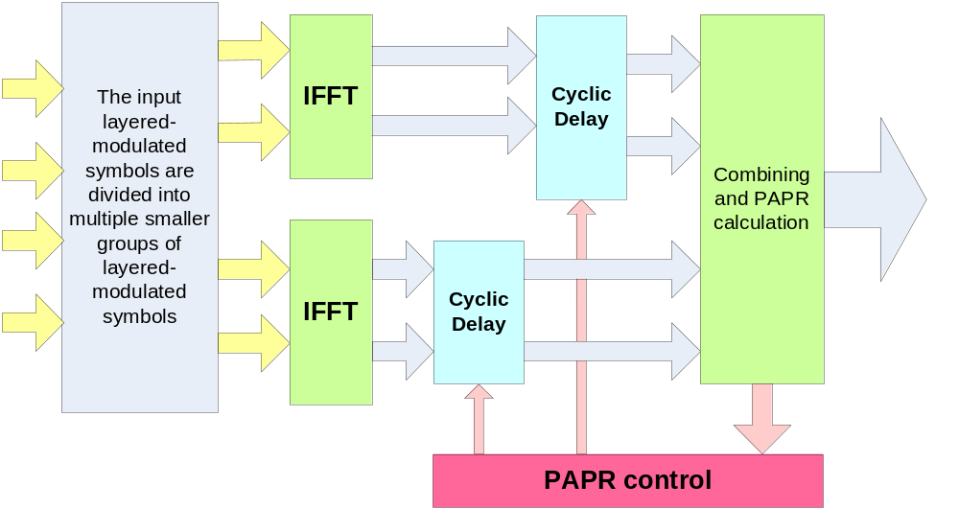
PAPR Reduction with Group-Based Cyclic Delay (1/2)

Slide 21
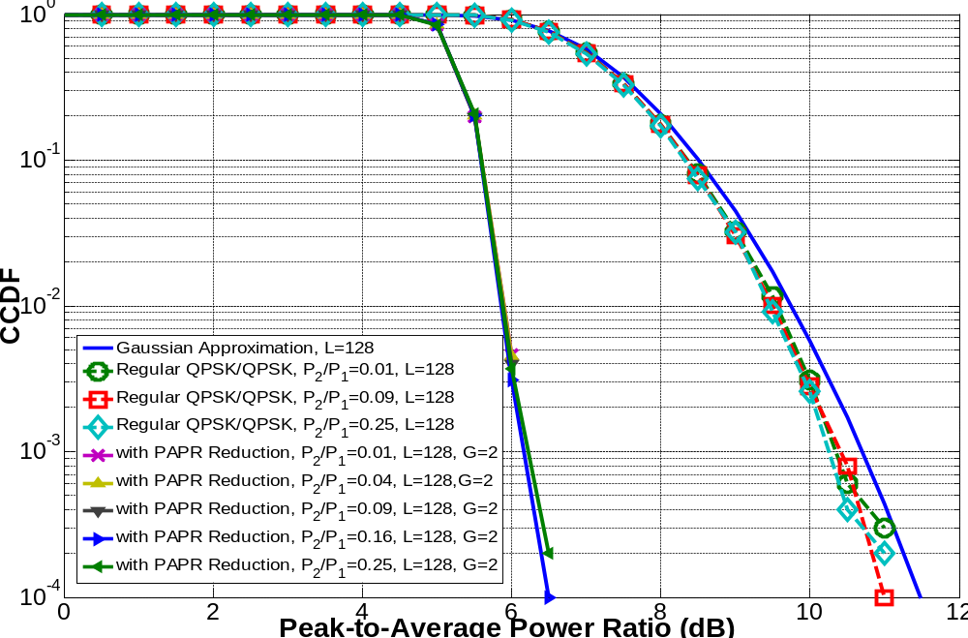
PAPR Reduction with Group-Based Cyclic Delay (2/2)

Slide 22

Conclusions
Hierarchical modulation has been adopted in various standards including MediaFLO, DVB-H and UMB.
The enhance hierarchical modulation is adopted in UMB, the salient features of which include
  minimum modulation/demodulation complexity increase.
  high bps: channel capacity gain on lower layer(s)
  lower BER: signal processing gain.
The enhanced hierarchical modulation is investigated in terms of
  achievable throughputs
  inter-layer interference
  asymptotic modulation efficiency
  peak-to-average power ratio
The enhanced hierarchical modulation is recommended for the next-generation standards.

Slide 23
References
T. Cover, Broadcast channels, IEEE Trans. Information Theory, Vol. 18, pp. 2-14, Janurary 1972.
G. Ungerbock, Channel coding with multilevel/phase signals, IEEE Trans. On Information Theory, Vol. 28, No. 1, January 1982, pp. 55-67
H. Jiang and P. A. Wilford, A hierarchical modulation for upgrading digital broadcast systems, IEEE Trans. Broadcasting, 2005
T. W. Sun, R. D. Wesel, Superposition turbo TCM for multirate broadcast, IEEE Trans. Communications, Vol. 52, No. 3, March 2004
Qualcomm Incorporation., FLO Air Interface Specification , 80-T0314-1 Rev. D
3GPP2, Ultra Mobile Broad Physical Layer, C.P0084-001, February 13, 2007
D. Gomez-Barquero and A. Bria, Feasibility of DVB-H Deployment on Existing Wireless Infrastructure, IWCT 2005
T. Cover and J. Thomas, Elements of information theory, John Wiley & Sons, 1991
P. P. Bergmans and T. M. Cover, Cooperative broadcasting, IEEE Trans. Information Theory, Vol. 20, pp. 317-324, May 1974.
C.-E. W. Sundberg, W. C. Wong and R. Steele, Logarithmic PCM weighted QAM transmission over Gaussian and Rayleigh fading channels, Proc. IEE, Vol. 134, No. 6, pp. 557-570, October 1987
L.-F. Wei, Coded modulation with unequal error protection, IEEE Trans. Communication, Vol. 41, pp.1439-1449, October. 1993.
LMQS, BCMCS in LBC, C30-20070131-001
LGE, Enhanced Hierarchical Modulation, C30-20070201-003, C30-2007-0206-004.
LGE, Zone-based BCMCS for HRPD, C30-20050214-014, Feb 2006.

Slide 24
Appendix

Slide 25
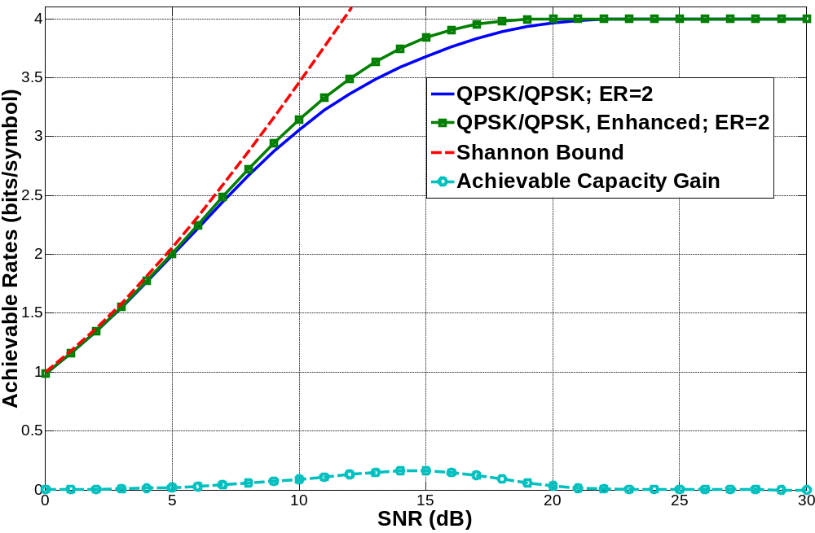

Slide 26
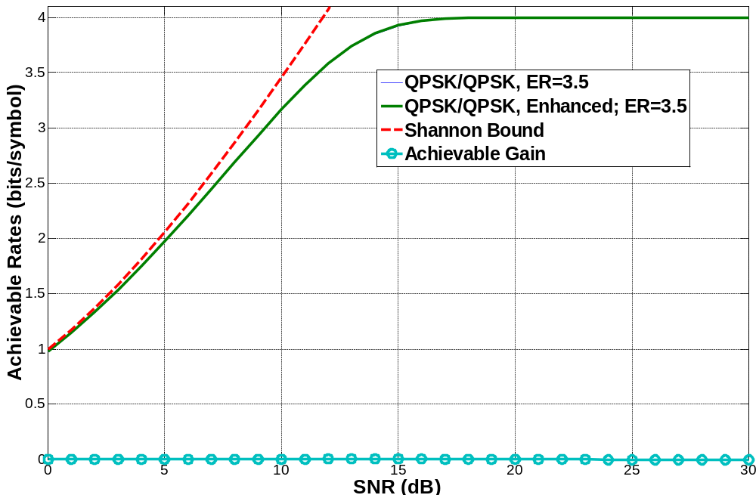
Achievable Rates for QPSK/QPSK, ER=3.5

Slide 27
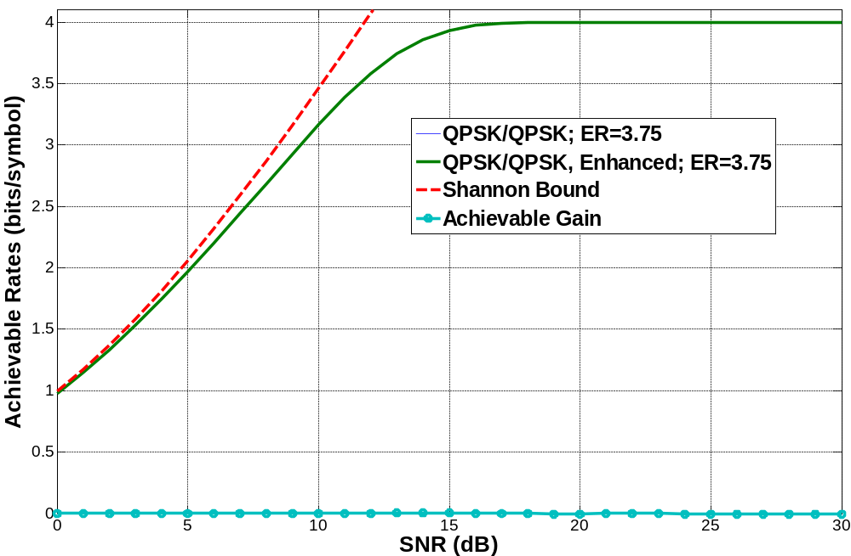
Achievable Rates for QPSK/QPSK: ER=3.75

Slide 28
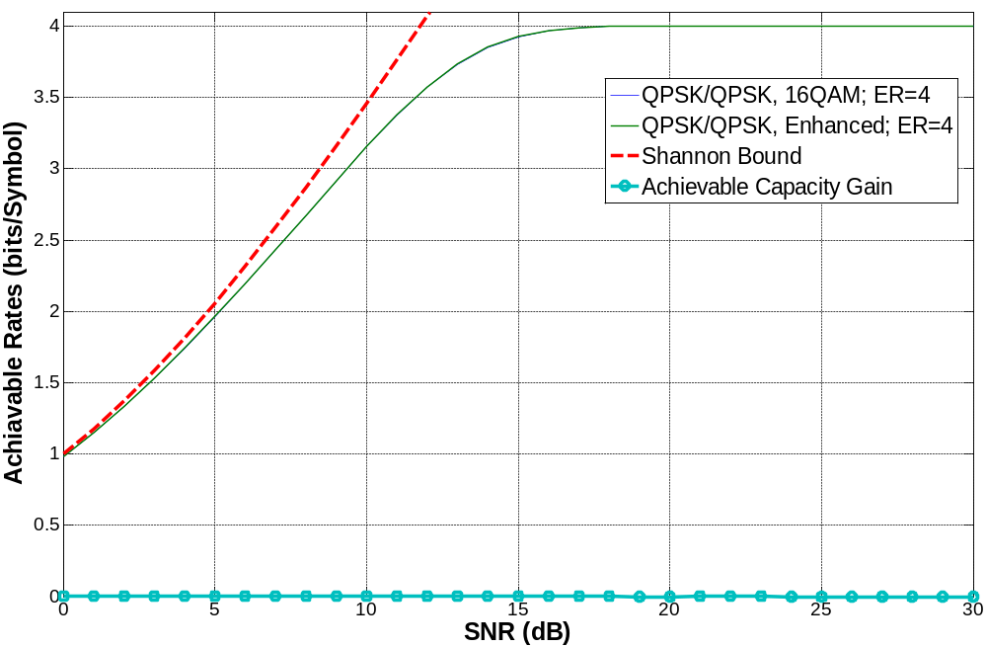
Achievable Rates for QPSK/QPSK, ER=4

